Slide 1
Project Management using Sapient|Approach
Day 1
Version 1.6.2
Last Updated: 20 February, 2008

Slide 2


Introductions
Name
Current role
Time with Sapient
Expectations from this class
S|A knowledge from 1 – 10 (where 10 is the highest)
Notes:
Speaker notes:
Capture participants expectations on the whiteboard.

Slide 3

Learning Objectives
Describe the S|A basics
Understand how S|A can be configured for Waterfall versus Agile
Understand how S|A applies to different contract models
Understand how to plan a Fusion
Scope a project
Estimate a project
Break down requirements into stories
Plan a project
Plan the EAR
Manage scope
Execute the EAR
Plan and execute a release
Monitor progress
Run a client checkpoint
Understand how to execute a manage engagement
Notes:
Speaker notes:
Walk through each objective and hence set expectations as to what will be covered in the next 3 days.

Slide 4
3 Day Agenda
DAY 1
DAY 2
DAY 3
S|A Overview
Plan a Fusion
Scope the project
Kick off the project
Execute the EAR
Prepare for the case study
Lunch
Scope the project (exercise)
Estimate and plan the project
Plan and execute a release
Execute a Manage engagement
Common pitfalls and stories from the field
Execute the case study
Close and feedback
Notes:
Speaker notes:
Day 1 focuses on a Project Manager’s areas of responsibility prior to the project being sold.
Day 2 focuses on a Project Manager’s areas of responsibilitiy during project execution.
Day 3 provides the group with the opportunity to bring everything together and practice what they have learnt.

Slide 5
Day 1 Agenda
8:00 – 8:30 Kick-off
8:30 – 11:00 S|A Overview (incl break)
11:00 – 11:30 Plan a Fusion
11:30 – 12:00 Scope the project
12:00 – 1:00 Lunch
1:00 – 2:15 Scope the project (exercise)
2:15 – 2:30 Break
2:30 – 5:30 Estimate and plan the project
5:30 – 6:00 Close and feedback
Notes:
Agende for NA and Europe

Slide 6
Day 1 Agenda
9:00 – 9:15 Kick-off
9:15 – 11:15 S|A Overview (incl break)
11:15 – 11:30 Plan a Fusion
11:30 – 12:00 Scope the project
12:00 – 1:00 Lunch
1:00 – 2:15 Scope the project (exercise)
2:15 – 2:30 Break
2:30 – 5:45 Estimate and plan the project
5:45 – 6:00 Close and feedback

Slide 7
Day 1 Agenda
8:30 – 8:45 Kick-off
8:45 – 11:00 S|A Overview
11:00 – 11:30 Plan a Fusion
11:30 – 12:00 Scope the project
12:00 – 1:15 Scope the project (exercise)
1:15 – 2:00 Lunch
2:00 – 4:45 Estimate and plan the project
4:45 – 5:00 Close and feedback
Notes:
Agenda for India (option 1)

Slide 8
Day 1 Agenda
9:30 – 9:45 Kick-off
9:45 – 11:30 S|A Overview
11:30 – 12:00 Plan a Fusion
12:00 – 12:30 Scope the project
12:30 – 1:00 Lunch
1:00 – 2:15 Scope the project (exercise)
2:15 – 2:30 Break
2:30 – 5:15 Estimate and plan the project
5:15 – 5:30 Close and feedback
Notes:
Agenda for India (option 2)

Slide 9

Ground Rules
Start on time
Mobile phones on mute
No side conversations
No beating a dead horse
No whining
Computer lids down unless explicitly instructed
FINE: ???

Slide 10

Sapient|Approach Overview

Slide 11
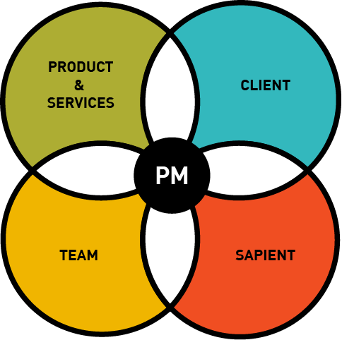
Sapient Project Management Model
The team delivers the products and services that fulfill the client‘s specific business needs
The clients have business needs that need to be addressed to contribute to their organisation‘s success, as well as their success within the organisation
The team consists of the people who will deliver the product, be it Sapient people or contractors
Sapient leadership has specific needs that are critical in order to fulfill the strategic context
Notes:
Speaker notes:
This diagram needs to be plotted out.
A PM is responsible for the delivery of a project and this can be broken into 4 key elements: (1) leading the team, (2) delivering the product, (3) working with the client, (4) fulfilling Sapient leadership needs. Each of these key elements have a direct impact on Sapient being able to fulfill the strategic context.
The PM needs to make sure each key element is optimal, and furthermore the PM is responsible for making sure that the interaction between each element is optimal.
Example:
Is the team interacting with the client as needed?
Is the client checkpoint at the end of each iteration to see the progress of the product?
Is the team building a product that fulfills the client needs?
Etc
The rest of the course is going to focus on each of these element.
Element examples:
Client
Relationship management
Client communication management
Reporting status to the client
Etc
Product & Services
Defining the scope
Driving the estimate
Kicking off the project
Etc
Team
Leading the team
Staffing the team
Motivating the team
Etc
Sapient
Driving project profitability
Managing margin
Managing time cards for the PM and the team
etc
Note that there are going to be overlaps between elements. Eg communication is a key R&R for the team, however it is also critical for the client.
The Sapient Project Management model highlights the integrated nature of the various elements of project management. For this training we are going to focus on the delivery aspect of it ie delivering the product and services, however we will highlight the impact on the other elements.

Slide 12

PM responsibilities for delivering the “Product and Services”
Prep – preparing for the project
  Define the scope
  Drive the estimate
  Develop the project schedule
  Support development of the price
  others...
Kickoff – getting the project off the ground
  Drive definition of project vision and goals
  Work with staffing to staff the project
  Plan the project
  Set up ResultSpace
  Drive the project kick-off
  others...
Execute – running and wrapping up the delivery
  Plan iterations
  Track overall progress
  Drive iteration execution
  Drive iteration closure
  Manage issues and risks
  Manage changes to scope
  Ensure audits and project reviews are happening
  Monitor quality
  Ensure that the tools are in place and are being used correctly
  Ensure Sapient|Approach is being used correctly and consistently
  others...
** Red items will be covered
Notes:
Speaker notes:

Slide 13

Sapient|Approach background
Sapient|Approach (S|A) defines the delivery model used to create success for our clients over the last 15 years
  Methodology
  Team structure and organization
  Distributed delivery - work anywhere, anytime
  Standardized tools and techniques
Based on Agile principles:
  Iterative
  Evolutionary design instead of “big upfront design”
  Embraces the reality that requirements change over time
  Working software (or completed deliverables) is the primary measure of progress
  Self organizing teams
  Focus on process automation
  Client collaboration, visibility and control
Notes:
Speaker notes:
Although S|A is based on Agile principles, S|A can be configured to cater for agile projects, waterfall projects etc. The broad principles apply to most project types with the exception of cases where the client specifies their own methodology that they insist we use.

Slide 14
Methods continuum
“Waterfall”
Hybrid Agile
“XP”
Deterministic
Evolutionary
Detailed plan for entire project
Scope-boxed phases
Track progress by tasks and milestones completed
Detailed documentation for all requirements
Short to medium length time-boxed iterations
Varying granularity plans
Track progress by value delivered
Risk-driven requirements documentation
1-week time-boxed iterations
Plan only current iteration
Track progress by working code
Tests are only long-term requirements documentation
Project Management
Create detailed interaction, visual and content design specifications for an entire site or application before any technical development starts
Creative and technology work streams completely separate
Create a high-level design and detailed design for key high-value/complexity sections of a site or application before technical development starts
Creative and technology work streams merge after high-level design
Design ‘in slices’ starting with only a list of requirements
No specifications
Creative Process
Big up front design
Just in time, quality
Development Process
Design all before coding in complete detail
Periodic builds
Integrate only once all code complete
Partial unit test coverage
Risk- and value-driven design choices – Executable Architecture
Daily builds
Continuous functional testing, largely automated
80% unit test coverage
Design all just-in-time – nothing up front
No design documentation
Continuous integration builds
Test-driven development; 100% unit test coverage
Low
High
Collaboration
Business involvement only at project start and completion
“Throw it over the wall” requirements communication model
Communication via periodic status meetings (monthly or greater)
Frequent, regular business involvement
Cross-group collaboration via frequent checkpoints
Cross-functional teams
Self-organizing teams
Daily “standup” meetings
Continuous face-to-face business involvement
Cross-functional teams
Pairing
Daily standup meetings
Notes:
We mentioned that the roots of Sapient|Approach 3 are in agile software development, At a high level here is how creative design is affected
this is the overview...3 dimensions
Historically projects have taken a waterfall approach. All the planning is done up front. The plan is very tough to change at the mid and end way points.
XP (Xtreme Programming): developer approach. No planning all coding right away. Quick white board sketch then dive in. Work directly and constantly with client. Create the solution, fix/change after. Benefits: fast, instant feedback, Loss: very hard to find a customer to sit with you all through this process.
Sapient has chosen a hybrid of the Waterfall approach and XP programming.
The problem with earlier projects is that very often the pieces are created but only intergrated close to the end test phase. If any errors are found there is not much time to correct it.
We are trying to shorten that whole phase but gathering the requirements, design and test in 3 week intervals, that way we can realize the risks much earlier and create the right solution in less time.

Slide 15
Traditional Waterfall versus Hybrid Agile
Many defects uncovered & fixed
Traditional Waterfall
1st time show app to client
Pilot
_{Fusion}
_{Define}
_{Design}
_{Implementation}
_{Deploy}
_{Support}
Hybrid-Agile
1st time show app to client
Pilot
_{Fusion}
_{Exec. Architecture}
_{Release 1}
_{Release 2}
_{Release 3}
_{Support}
Benefits of Hybrid agile
Earlier deployment -> earlier ROI from efficiencies
Better quality at deployment time
Timelier feedback
Better relationship with business people (due to higher quality)
Less wasted documentation
Notes:
Speaker notes:
The key benefit of Agile is that it is possible to show the client something sooner.

Slide 16

S|A project lifecycle
Sapient|Approach
Fusion
Exec. Architecture Release
Release 2
Release 3
Manage
It 1
It 2
It 3
It 4
It 5
It 6
It 7
It 8
It 9
It 10
It 11
It 12
Iteration N
Go Live
Kick
off
Client team: acts as interface to client, does some dev work
GDD Team: develops and tests
Check
point
The Project Life Cycle is composed of:
  Fusion
  EAR
  Ongoing Releases
Project Structure is made up of the following key components:
  Releases: large, logical, functioning portions of a solution that may or may not be deployed to a production environment
  Iterations: 1-4 week time boxed period of time at the end of which we deliver working software (or paper for early iterations)
  Stories: small chunks of work to be completed with an iteration
Notes:
Speaker notes:
Executable Architecture Release (EAR)
The purpose of the EAR is to do the minimum amount of work to understand the problem and commit to a solution
To achieve this each team must assess what combination of requirements, analysis, development and design activities are necessary to mitigate both requirement and technical risks associated with the project
Release Planning
A release must happen no later than every 4 months
Release lengths can be different from release to release
Work with client to identify target functionality for first release: what is their “minimal marketable feature set?”
The smallest subset of the solution’s capabilities that would have value for the client
Know that the mid-level plan will change, don’t try to get too precise
Iteration Planning
An iteration length is 4 weeks
Focus on “Done is Done” while talking about iteration planning
Deliverables must be production-ready at end of every iteration
No separate “clean up” phase
Forces decision making and closure on the things of immediate concern
Need to leave time to do closeout within the iteration
How to introduce STORY
This fundamental concept is best discussed early and often
When discussing the term for the first time, emphasize that it is a way to decompose the work into a manageable chunk.
Easiest way is to get class engaged
Draw up the name of a piece of scope: e.g., a use case for a trading system: Execute a Trade
Ask the class to decompose this in a typical waterfall, WBS (work breakdown structure) fashion. You should get a ilst of tasks like ‘build a wireframe, write db query, build HTML,write unit tests, write Java module. etc.’
Stress that neither of these on their own provide a real sense of progress. It’s not possible to know until testing (which usually occurs later) whether these will really work
Draw a picture showing that these tasks are all horizontal slices of how the functionality comes together
Discuss the “Story” an alternative way to decompose the same work; how a story is vertically-oriented, and takes the piece of functionality and builds it up in laters. One story might be “execute a simple trade with 1 instrument” as the first part, then layer on other features such as detailed validation, etc. You can emphasize the vertical nature of these stories, and also that each on includes full testing.
Touch on this info again on slide 19.

Slide 17
Sapient|Approach in action
Demonstrate an actual project in ResultSpace
Notes:
Spend 5 minutes pointing out the real-life situation with a project the instructor is familiar with. Pull up ResultSpace to show the highlevel plan, key milestones, and the current iteration plan.

Slide 18
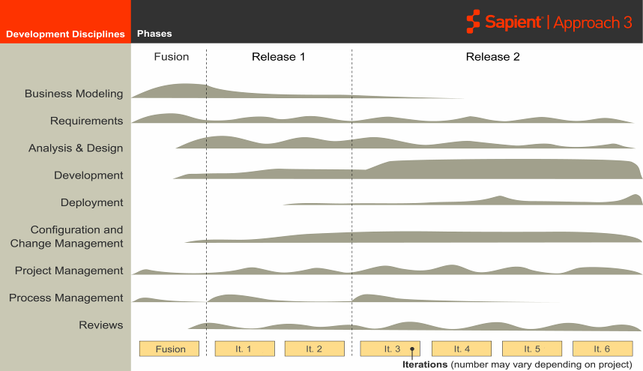
Project life cycle – another view
EAR
Requirements, Analysis & Design, Development and testing occur throughout the project life cycle

Slide 19
Project life cycle deliverables
Opportunity
Development
Fusion
EAR
Release 2
Manage
Client artifacts
RFI
Client artifacts
Meeting minutes
SOW
Fusion Scope
Fusion Plan
Fusion Estimate
Project Scope
HLP
EAR Release Plan
Fusion artifacts
Release Plan
Design documents
Core functionality built and tested
Known defects and potential enhancements
SLA
INPUT
Meeting minutes
Fusion scope and/or SOW
Fusion estimate
Fusion plan
Fusion price
Vision including customer / user experience reqs
MBRs
Key features (high level Req.)
Scope Matrix (high level Use Cases)
Program governance (Risks Plan, Com-munication plan)
Validated HLP
Estimate for EAR
Price for EAR
Price range for Release 2
Release Plan for EAR
10-20% of application built and tested
Test Plan
Automated tests for EAR functionality
Use Cases
Baseline logical architecture diagrams
Baselined physical architecture diagrams
Baseline system architecture diagrams
Baseline logical/physical data model
High risk/value wireframes and screen mock-ups
Release plan for Release 2
Price for follow-on releases
Implemented and tested functionality
Automated regression test suite
Client checkpoint every 4 weeks
Updated data model, external system specifications
Estimate and SOW for Manage
SLA reports
New functionality implemented and tested
Automated tests for new functionality
Additional wireframes
Visual design build out/assets
Annotated wire frames/functional specifications
Copy Deck
OUTPUT
Creative Brief/Concept Document (may be incorporated into Vision Document)
Baseline Sitemap
High risk/value wireframes and screen mock-ups
Visual Look and Feel
Content Matrix/Voice & Tone Guidelines
Creative-oriented
Notes:
Speaker notes:
Mention that the ideal case is for a project to do a Fusion -> EAR -> Releases -> Manage
However there are several other variations of this, and one that we often see is RFP -> Releases -> Manage
It is still required that the project defines the artifacts that would typically be output from a Fusion, even if there is no Fusion.
Many times stand alone creative projects involving user research or concept works serve as defacto fusions, with design and/or design and implementation work following
For ‚creative only‘ projects where deliverables are either paper or front end only code, outputs look may look different (click through)

Slide 20
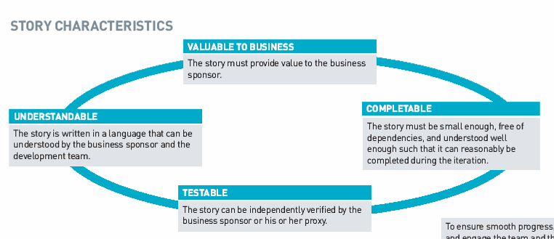
Story definition
A story is the fundamental unit of work and the primary unit of planning, execution and communication between client and the team
Notes:
Speaker notes:
Emphasise the fact that a story is really a way of breaking down work into smaller more manageable pieces.
Re-iterate that early on in the project, many stories may be paper based to document the breadth of requirements.
Ask participants for examples of what a good or bad story is.

Slide 21

Why use stories?
Stories focus the development team and the business sponsor continually on value and not merely tasks
Stories are in a language that both developers and customers can understand
  The business sponsor can truly be a partner in the development and can provide feedback on the direction of the project
Each story represents actual incremental value for the business user
  In many cases the business sponsor can get business value immediately from a story
  By delivering completed stories, the team makes tangible progress towards the business sponsor’s goal

Slide 22
Story Examples
Which are good stories and which are bad?
  User can use hotel website
  User views hotel search results with no hotels
  User views list of hotels based on input location (no date, #rooms, guests specified)
  Evaluate, select and install automated testing tools
  System uses Log4J to log all error messages
  Model hotel booking workflow
  Develop vendor API proof of concept (spike)
  Document test plan
  Graphing and charting shall be done using Business Objects
  User configures the number of hotels displayed on the page
  Model document management use cases
  User exports the hotel information to Microsoft Word
  Document hotel availability rules
  Develop the persistence framework
  Develop the hotel details view JSP
  Define visual look and feel round 1
Notes:
Speaker notes:
When introducing this exercise, set expectations, that there are different types of good stories. There are the types that are broken down directly from user requirements ie User stories. But there are other stories that also fulfil the criteria but may not be broken down from the user requirements eg infrastructure stories, documentation stories, etc.
User can use hotel website. BAD
User views a hotel list with no hotels. GOOD
User view list of hotels based on input location (no date, #rooms, guests specified). GOOD
Create moodboard BAD (task not story)
Evaluate, select and install automated testing tools: GOOD
System uses Log4J to log all error messages. BAD
Model purchase order workflow: GOOD
Develop vendor API proof of concept (spike): GOOD
Document test plan: GOOD
Graphing and charting will be done using Business Objects. BAD
User configures the number of hotels displayed on the page. GOOD
User exports their hotel information to Microsoft Word. GOOD
Document hotel availability rules: GOOD
Develop the persistence framework. BAD
Develop the hotel details view JSP. BAD
Define visual look and feel round 1 GOOD

Slide 23
A typical release
Sapient|Approach
Fusion
Exec. Architecture Release (EAR)
Release 2
Manage
It 1
It 2
It 3
It 4
It 5
It 6
It 7
It 8
It 9
It 10
It 11
Iteration 6
Iteration 7
Iteration 5
Iteration 6
Iteration 7
Iteration 4
Iteration 5
Iteration 4
KICKOFF
Story 1
CHECKPOINT
KICKOFF
Story 8
CHECKPOINT
KICKOFF
Story 14
CHECKPOINT
KICKOFF
Story 23
CHECKPOINT
Story 2
Story 9
Story 15
Story 24
Story 3
Story 10
Story 16
Story 25
Story 4
Story 11
Story 17
Story 26
Spike Story 5
Spike Story 12
Story 18
7 UAT Test
Story 6
Story 13
Story 19
8 Deploy
Story 7
Story 20
Story 21
Story 22

Slide 24
Define the customer tests
One of the first things that needs to happen during or before iteration kickoff is to define the customer tests for each story
Customer tests define the business value for each story in the form of tests that need to pass in order to complete the story
Iteration 4
Iteration 4
Story 1: CUSTOMER TESTS
User is able to enter content in the article content management screen | Not passed
The content entered in the article content management screen is visible on the portal site | Not passed
Article portal page maps to the wireframe provided for Article page | Not passed
Develop email wire frames: CUSTOMER TESTS (CD)
Client Approval | Not passed
90% task completion rate with little or no help and/or some help in paper prototype testing | Not passed
Use Cases xyz covered by screens | Not passed
KICKOFF
Story 1
CHECKPOINT
Story 2
Story 3
Story 4
Spike Story 5
Story 6
Story 7
Notes:
Speaker notes:
Tests for creative stories look a bit different

Slide 25
Task out the stories
A Story includes both development and testing tasks. It takes joint team of developers and testers to deliver a full story
A release may be to a QA environment (e.g. for formal User Acceptance activities, Disaster Recovery testing, etc.) or it may be an actual commercial release
Some Iterations of a Release focus on clients testing the application for User Acceptance. Client Suppliers, distributors, customers get involved at that time
Visual Look and Feel Round 1
Review Branding Guidelines and style guide | Visual Designer
Create mood board | Visual Designer
Mock up home page | Visual Designer
Mock up secondary page | Visual Designer
Peer review | Another Creative
Client Presentation | Visual Designer
Iteration 4
Story 1: TASKS
Just in-time design | Developer Tester
Create Test Data | Developer
Create Automated Unit Test | Developer
Create ViewPage.jsp | Developer
Create the Database Table | Developer
Create Data Transfer Object | Developer
Manually Test the Page | Developer
Test the story | Tester
Automate the Regression Tests | Tester
Bug Fix | Developer
Iteration 4
KICKOFF
Story 1
CHECKPOINT
Story 2
Story 3
Story 4
Spike Story 5
Story 6
Story 7
Notes:
Speaker notes:
Sample tasks for a creative story, in this case there may be only anywhere from 1-3 designers working on the story and the ‚release‘ is to the client for approval or rework-usually there is more than one design approver and rework is the rule rather than the exception

Slide 26
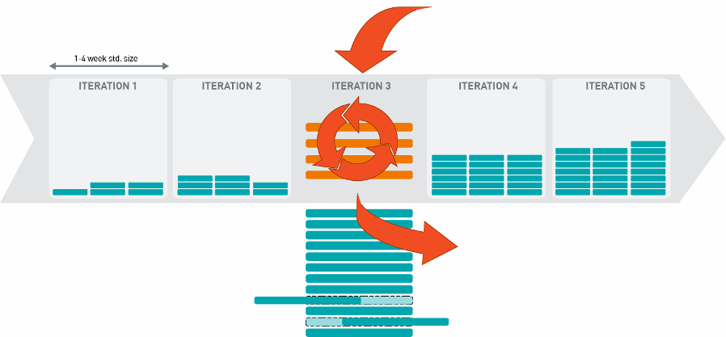
Executing a release
Opportunity to inject business priority change
Work executed as a series of time-boxed iterations
Story
Story
Story
Story
Story
Story
Story
Story
Story
Story
Story
Story
Story
Story
Story
Story
Story
Story
Story
Story
Story
Story
Story
Story
Story
Story
Story
Story
Story
Story
Story
Story
Story
Story
Story
Story
Story
Story
Story
Story
Story
Story
Story
Story
Story
Story
Story
Story
Story
Story
Story
Story
Story
Story
Story
Story
Story
Story
Story
Story
Story
Story
Story
Output of each iteration is
production quality.
New stories can be added,
and other stories swapped out
as business needs change
Story
Story
Lower value stories will be
pushed down.
Notes:
Speaker notes:
Key message: Iterations provide incremental value. It it not an opportunity to go round and round in circles and not close something. On the contrary…you must force closure at the end of each iteration or else the project will never be done. Hence the importance of the „done is done“ concept.
The S|A iteration is more specific than many definitions seen in other well-known methodologies. Specifically: the team must deliver something that is of such high quality (ie no P1s and P2s) that it could potentially be deployed.
The PM is key in enforcing this level of discipline and holding the team accountable for the high quality.
It is typically the role of the PM to facilitate the iteration kick-off meeting.
This includes showing the client what was originally planned for the iteration, and then providing them with the option to swap scope if they feel it is necessary. It is providing this choice that is very powerful. We have seen from projects that many times, after seeing what was delivered, clients have made scope choices that they may not have if they had not seen working code.

Slide 27
Overview of types of stories
Sapient|Approach
Fusion
EAR
Release 2
Manage
Iteration 1
Iteration 2
Iteration 3
Iteration 4
Iteration 5
It 6
It 7
Plan and estimate
EAR
Plan and estimate
next release
Plan and estimate
next release
Set up
infrastructure
Define Test Strategy
Support UAT
Define use case
model
Detail high
risk/priority
Use Cases
Detail lower priority
Use Cases
Define High level
Site Map
Create high risk/value
wireframes
& Funct Specs
Create high risk/value
wireframes
& Funct Specs
Create wireframes
& Funct Specs
Create wireframes
& Funct Specs
Define High Level
Technical Arch
Define detailed
Technical Arch
Build spike
solutions
Define detailed req,
Build and test
highest risk / value
core functionality
Define detailed req,
build and test
highest value
functionality
Define detailed req,
build and test
highest value
functionality
Define detailed req,
build and test
highest value
functionality
Notes:
Speaker notes:
This slides highlights the type of stories that will be in placed at various times in the project life cycle.
Make a point of noting, that these are not stories in themselves. Eg Define detailed requirements, build and test is not a story. Instead you would have an actual feature, and what would be done for that story would be defining the detailed requirements, building and testing.

Slide 28
When the client demands waterfall
Sapient|Approach (Waterfall configuration)
Fusion
Design
Implementation
EAR
Release 2
Manage
Iteration 1
Iteration 2
Iteration 3
Iteration 4
Iteration 5
It 6
It 7
Plan and estimate
EAR
Plan and estimate
next release
Plan and estimate
next release
Design
Set up
infrastructure
Define Test Strategy
Support UAT
Define use case
model
ALL
Detail high
risk/priority
Use Cases
Detail lower priority
Use Cases at
Same level of detail
Define High level
Site Map
ALL
X
X
Create high risk/value
wireframes
& Funct Specs
Create high risk/value
wireframes
& Funct Specs
Create wireframes
& Funct Specs
Create wireframes
& Funct Specs
Define High Level
Technical Arch
Define detailed
Technical Arch
ALL
Build spike
solutions
Define detailed req,
Build and test
highest risk / value
core functionality
Define detailed req,
Build and test
highest value
functionality
Define detailed req,
Build and test
highest value
functionality
Define detailed req,
Build and test
highest value
functionality
Notes:
Speaker notes:
Key message is that using standard S|A is mandatory. However if for some reason the client is mandating that Waterfall be used, S|A can be configured to cater for this.
This slide highlights the primary differences between using standard S|A, and S|A using a waterfall configuration.
Key messages:
Stories are still the primary unit of work
Iterations are still used
All documentation is completed with a consistent level of detail (regardless of risk and complexity), which is contrary to a true Agile approach
All requirements are finalised and documented by the end of the EAR (or Design Phase).

Slide 29
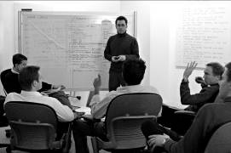
Class Exercise #1
Waterfall versus Agile
Instructions (Total time required 20 min)
Split into 2 groups
  Group 1: Agile
  Group 2: Waterfall
Assign the stories to iterations (10 min)
Present your results
Notes:
Speaker notes:
Make sure you have 2 plots of the S|A HLP stuck on the wall. (1) Waterfall configuration, (2) Agile version
Give group 1 the cards containing stories for the Waterfall configuration of S|A.
Give group 2 the cards containing stories for the Agile configuration of S|A.
Ask each group to stick/place the cards in the appropriate iteration.
See Facilitation notes for details on how to facilitate this session.

Slide 30
Key Takeaways
S|A is configurable
The key principles still hold regardless of what configuration
Agile v Waterfall similarities include use of:
  Iterations
  Stories
  Releases
  Tackle high risk upfront
Agile v Waterfall differences
  For a Waterfall configuration, all documentation must be 100% complete by the end of the EAR
  Level of documentation detail is consistent regardless of risk
  May or may not do coding during the EAR

Slide 31
Contracting options
Contractually fixed versus flexible requirements
FT/FP versus T&M
Capacity agreement
How does each work with S|A 3?

Slide 32
Contractually Fixed versus Flexible Requirements
 | Fixed | Flexible
Description | Requirements and deliverables are fixed upfront and embedded into the contract Changes to requirements (scope) are tightly controlled via change request process to ensure contractual compliance | Requirements are defined, estimated and agreed to but are not contractually binding As system evolves client and Sapient collaborate to identify the features that will deliver the most value in the time and dollars budgeted Mechanisms other than fixed requirements are put into the contract to ensure the client receives value and that Sapient is protected Changes to requirements are managed through swapping stories in and out, without having to go through a controlled change request process
When to use | A trusted relationship between Sapient and the client is not present | A trusted relationship has been built with the client
Pros | Clear expectations are set upfront | Best approach for driving client value We do provide an upfront idea of the level of value we will deliver. However, the exact functionality delivered will nearly always be different than what was originally envisioned
Cons | Implementing change requests will continue to be a cumbersome process | Requires strong scope management skills from the PM Risk that requirements will never close and continue to iterate in a spiral effect
Notes:
Speaker notes:
There are several ways a contract can be set up. The way that Sapient has traditionally defined contracts is fixed time, fixed price and a fixed scope or fixed requirements. Sapient is then contractually committed to deliver all the scope in the contract. Now if business requirements change, resulting in a need to change the scope, a stringent scope change request process must be followed.
However to truly reap the full benefits of Agile, an initial scope will be defined, however it will be stated in the contract, that the client and team have the option to swap scope in or out at the start of each iteration without following a stringing change request process. This does have a fundamental impact on how scope is managed, which we will cover later.

Slide 33
FT/FP versus T&M
 | FT/FP | T&M
Description | Sapient contractually commits to delivering the agreed upon scope (either fixed or flexible requirements) for a fixed price by a fixed date | The client pays for every hour worked (there are several configurations of this contract type) Client is typically responsible for the management and direction of the project
When to use | Time and budget are the primary business drivers The client has requested it | Time and budget are not a primary driver, and the client wants the flexibility to be able to extend the project timeline and scope The client has requested it Staff augmentation projects
Pros | Incentive for the team to deliver what is absolutely critical in order to be able to meet the timeline | Provides the client with the flexibility to change scope/direction without stringent contractual restrictions
Cons | Sapient suffers the financial consequences if the project is not delivered on time or more people are needed than initially estimated | Less clarity with reference to the funding or timeline nexessary to achieve the desired result Incentive to gold plate
Notes:
Speaker notes:
Historically Sapient has focused on FT/FP contracts. However there has been a shift in how we think, and T&M is no longer considered taboo. In fact, if the client wants T&M, we are happy to abide. Similarly, if they want FT/FP, we are also happy to abide.

Slide 34
Capacity Agreement
Capacity Agreement
Description | Scope of services is defined in terms of capacity (team size/composition), quality and response time Service levels are defined against one or more solutions Team reacts and prioritizes continuously based on planned and unplanned requests from the client
When to use | Time and budget are the primary business drivers The client has requested it
Pros | Well suited for circumstances where requirements and tasking are more fluid from week to week (eg. “Manage” style engagements) This model caters well to projects where “business continuity” is a high priority
Cons | Not typically appropriate for new systems development
Notes:
Speaker notes:

Slide 35
Planning Fusion

Slide 36
Fusion overview
Sapient|Approach
Fusion
Exec. Architecture Release
Release 2
Release 3
Manage
It 1
It 2
It 3
It 4
It 5
It 6
It 7
It 8
It 9
It 10
It 11
It 12
Go Live
Fusion is the initial phase of a project
Acts as a fast-paced, hyper-productive jumpstart, with the core being a workshop
Objectives:
  Identify and define a clear opportunity or challenge
  Build consensus and momentum within the client organisation
  Establish a common language, vision and understanding
  Create and enable a roadmap for action
  Understand requirements
  Set expectations about how the project will be run (using S|A)
Notes:
Speaker notes:
Planning and estimating a Fusion is more based on experience and is more of an art than a science, because at this point in time, the team knows relatively little about the project. To be able to plan a Fusion, the PM needs to understand the business problem, and where they are at with regards to solving it. Other things to consider are, is it a stand-alone Fusion versus the first part of a development project. If the team is conducting interviews, how many people need to be interviewed?
In creative design projects ‚concept development‘ and related activities often serve as a fusion. This work defines who the users/market is what potential use cases for an application or site may exist – and in many cases follow on work is not even yet a consideration – we are hired simply as an agency. Depending on the client/project there may or may not be a workshop. For more traditional requirements heavy web builds, it is recommended. For more marketing/agency type work it may not be appropriate or expected considering industry norms.

Slide 37
Fusion mechanics
A Fusion begins with client interviews, checkpoints, research all focused around the central activity, the workshop
A Fusion concludes with a consolidated document that captures all findings, outcomes, and next steps
Typical durations and sizes
  Fusion duration: 3 - 4 weeks
  Fusion workshop duration: 2 – 5 days
  Sapient Team size: 6 – 10 persons
Preparation
Workshop
Consolidation
& Deliverable
Notes:
Speaker notes:
Remind participants on what they learnt during Fusion Workshop training.
Workshops are more than just the event itself. Workshops require significant planning and the creation of deliverables afterwards.
Teams will need people focused on the workshop preparation, and another team focused on content eg interviews, starting coming up with strawmen etc.

Slide 38
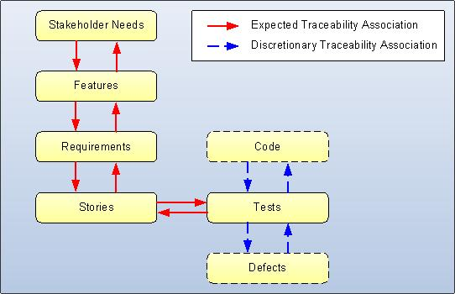
Identifying requirements during Fusion
Features identified during the fusion are translated into requirements using a user centric approach
  The team breaks up requirements (use cases) into stories
  At the beginning of every iteration, the story stack is shuffled to maximize value and work on the most critical / risky features
Notes:
- Traceability

Slide 39
How to plan and estimate Fusion
Planning process
  Establish objectives
  Clearly define the deliverables
  Identify key stakeholders
  Design a plan that meets the following:
    Under-promises and over-delivers on the objectives
    Sets expectations about format, content, due dates and owners for final deliverables
    Meets the expectations of the key client stakeholders
  Define how many people are needed from Sapient
Things to consider:
  What constraints exist eg budget, people availability, key dates?
  How much needs to be driven from the group in the workshop, versus prior to or after the workshop?
  Who is required from the client and when? Eg how many people need to be interviewed?
  What Sapient roles are needed to fulfil the objectives?
  Is the client expecting a plan and estimate for the next phase of work?
  How much work has the client done already eg does the client have requirements already defined?
Notes:
Speaker notes:
Planning and estimating a Fusion is more based on experience and is more of an art than a science, because at this point in time, the team knows relatively little about the project. To be able to plan a Fusion, the PM needs to understand the business problem, and where they are at with regards to solving it. Other things to consider are, is it a stand-alone Fusion versus the first part of a development project. If the team is conducting interviews, how many people need to be interviewed?

Slide 40
Scope the project

Slide 41
Define Scope
1. SCOPE
(the what)
2. ESTIMATE
(the effort)
3. PLAN
(the when)
4. PRICE
(the cost)
Tool:
Scope Matrix
Tool:
Estimation sheet
Tool:
High Level Plan
Tool:
Deal Tool
What are we going to do?
Why are we doing it?
How will it be done?
What risks are there?
What is the effort required?
Who will do it?
When will it be done?
What assumptions are we making?
How much will it cost?
Notes:
Speaker notes:
A critical part of selling a project is planning it. Typically a BD team will consist of a CE, a senior PM, Arch and perhaps other SMEs. Typically the senior project manager will drive and own planning the project. The planning should be treated as a mini-project in itself ie it needs to be planned, managed and tracked.

Slide 42
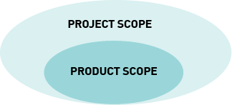
What is project scope?
Project Scope defines what Sapient commits to delivering to the client
Product Scope is documented in the Scope Matrix and consists of:
  Functional Requirements
    List of Use Cases
      Requirements may come in other forms such as declarative statements from the client
      Use Cases may not be appropriate for some projects eg EAI, middle tier etc
    Reports
    Feeds and interfaces
    etc
  Non-Functional Requirements
    Performance
    Availability
    Scalability
    etc
  Assumptions
  Deliverables and Services
Develop a business plan
FUNC REQUIREMENT 123
Execute a 2-party trade
NON-FUNC REQUIREMENT
Response time on IE less than
1.5 sec per transaction
Notes:
Speaker notes:

Slide 43
Use Cases
A Use Case defines how the system will be used by a user/system to achieve a specific goal
Use Case details evolve throughout the project and should:
  Focus on what the system must do, not how it is done
  Have no implementation specific language
  Be at the appropriate level of detail (high risk use cases have more detail)
  Not include details regarding user interfaces and screens (but can reference them)
Example Use Cases:
  Search for a flight
  Book a flight
  Email flight information to a friend
  Check availability of flights
  Check flight status
Notes:
Speaker notes:
For more information on Use Cases, go to www.wikipedia.com, and search on Use Cases.

Slide 44
Why use use cases?
Use Cases:
  Provide a simple way to understand the solution from a user perspective
  Provide a high level view of the overall integrated solution
  Act as a bridge between users and the developers/creative designers
  Are used as a basis for estimating, scheduling and validating efforts
  Can be evolved and can be used for tracability from requirements to stories to code
  Make it easy to take a release approach to projects; associated stories can be relatively easily added and removed as priorities change
  Test cases can be directly derived from use cases

Slide 45

Use Case Evolution
Fusion
EAR
Prep
Workshop
Consolidate
Iteration 1
Use Case Model
Scope Matrix (initial version)
Use Case Details
Register for frequent flyer program
SCOPE MATRIX
Functional Requirements
  Register for frequent flyer program
  Find out frequent flyer miles
  Search for flight
  Check availability of flight
  Book flight
  Trace baggage
  Check flight status
  Look for employment
  Read press releases
  Download press items
Non-Functional Requirements
  Performance
  Booking page must be faster than n seconds
  Usability
  No more than 5 mouse clicks to book a flight
  …
Use Case:
Register for Freq Flyer Program
Actor: Traveller
Description: User is able to register for a frequent flyer program
Basic
Find out freq flyer miles
Check flight status
Traveller
Search for flight
Family/friends of
Traveller
Use Case:
Find out frequent flyer miles
Actor: Traveller
Description: User is able to find out status of their frequent flyer program
Precondition: Traveller is registered…
Seek employ-ment
Detailed
Check availability of flight
Professional
Read press releases
Book flight
Use Case:
Find out frequent flyer miles
Actor: Traveller
Description: User is able to find out status of their frequent flyer program
Precondition: Traveller is registered…
Trace baggage
Download press items
Journalist
Fully Dressed
System Boundary
Notes:
Speaker notes:
For more detailed information on Use Cases and the history of them, go to www.wikipedia.com, and search on Use Cases.

Slide 46
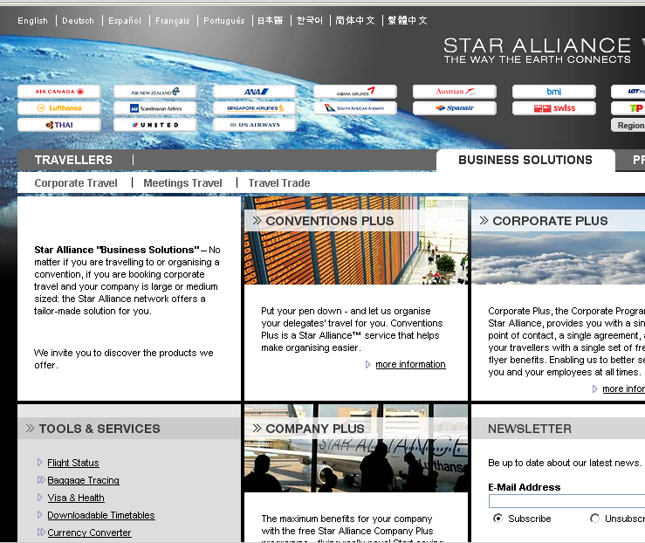
Supporting artifacts
EAR
Iteration 1
Use Case Details
Supporting artifacts
(if needed)
Use Case:
Register for Freq Flyer Program
Actor: Traveller
Description: User is able to register for a frequent flyer program
Supporting artifacts are often required to help understand the requirements e.g. wire frames, sequence diagrams, etc.
If sufficient supporting artifacts already exist, and as a result the use cases are fully understood, the use case details do not need to be created
  S|A recommends that at a minimum a Use Case Model be defined that highlights the interactions between the use cases
Basic
Wire frames
Use Case:
Find out frequent flyer miles
Actor: Traveller
Description: User is able to find out status of their frequent flyer program
Precondition: Traveller is registered…
Detailed
Scren comps
…
Activity diagrams
Notes:
Speaker notes:
For more detailed information on Use Cases and the history of them, go to www.wikipedia.com, and search on Use Cases.

Slide 47
But what about when…
…the client delivers pages and pages of detailed requirements
  Create Scope Matrix to reflect the detailed requirements you have received from the client
  Use client documentation as record of requirements instead of use case details
…the client says that requirements have been defined and use cases are not necessary
  Validate that the requirements are defined in adequate detail. If not, create use case details
  Create Scope Matrix based on the client requirements defined
…the project is a straight port from one technology to another
  Use the existing client documentation and application to define the Scope Matrix
  Use existing client requirements documents (if they exist and are of an acceptable quality) instead of Use Case details
…we aren‘t building anything, just delivering a concept or paper designs?
  Use the Deliverables and Services tab in the Scope Matrix
  Use bounding assumptions to detail out ranges and limits of deliverables (x number wire frames, etc.)
Notes:
Speaker notes:
This slide builds with the appropriate response for each scenario. Ask the class what they would do for each scenario.
Key takeaway, if the client is supplying detailed requirements or has existing requirements documented,
For more information on Use Cases, go to www.wikipedia.com, and search on Use Cases.

Slide 48
Scope Matrix life cycle
Planning
Fusion
EAR
Release 2
Manage
Client docs
Meetings
Past scope
Matrices
…
Fusion artifacts
Client meetings
Workshops
Interviews
…
Fusion artifacts
Client meetings
Workshops
Iteration
kick-offs
Project artifacts
Client meetings
Workshops
Iteration
kick-offs
Project artifacts
Open defects
SLA
INPUT
Potentially create Scope Matrix during opportunity shaping
Create project Scope Matrix with the client identifying the risk and business value
Validate high level scope defined during Fusion.
Baseline the Scope Matrix Within the first few weeks of the EAR
Update the Scope Matrix as new requirements surface and are agreed upon.
Validate project scope.
Baseline the Scope Matrix within the first few weeks of the release
Update the Scope Matrix as new requirements surface and are agreed upon.
Potentially create Manage Scope Matrix for enhancements.
Validate engagement scope.
OUTPUT
Fusion
Scope Matrix
and/or
Scope defined
in SOW
Project
Scope Matrix
Updated
Project
Scope Matrix
Updated
Project
Scope Matrix
Manage
Engagement
SLA
Notes:
Speaker notes:
Scope is defined at a high level before the project starts (while it is still an opportunity), and then evolves as we gather more information about what the client wants. This information is gathered through a variety of sources (the ones listed are just a subset of those).
Each Scope Matrix should be baselined at the start of a release.
Note that the definition of the Scope Matrix may differ depending on the contractual setup. Eg if only the EAR has been sold after Fusion, you will have a Scope Matrix for the EAR, then once R2 has been sold, you will set up a completely new scope matrix.

Slide 49
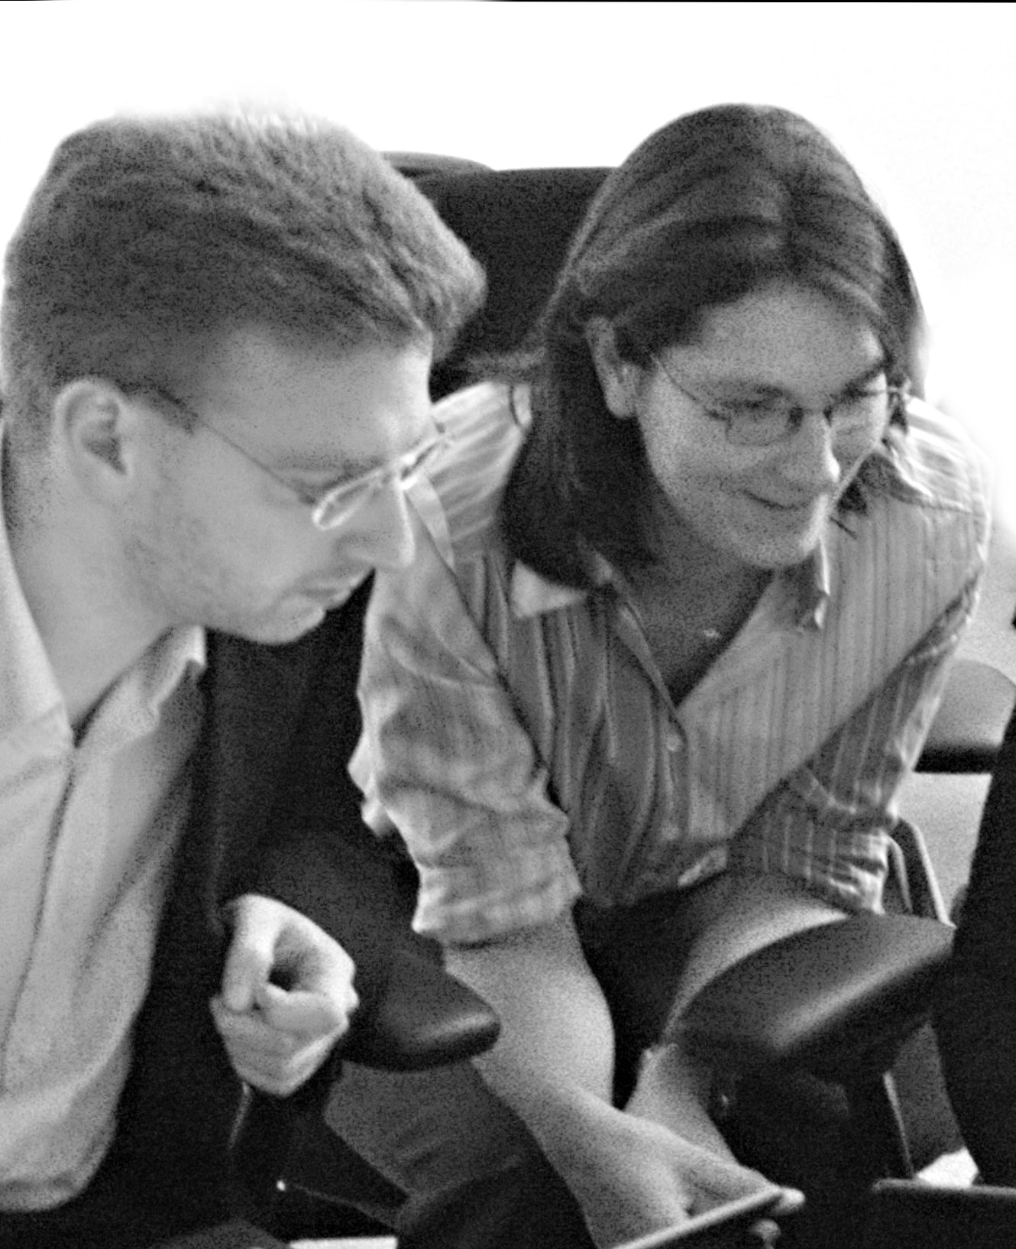
Class Exercise #2
Defining Scope
Instructions (Total time required 75 min)
Divide into teams of 2
Read through the case study
Download the Scope Matrix from the Intranet
Create one Scope Matrix per team based on the case study (50 min)
Debrief (25 min)
Notes:
Speaker notes:
See Facilitation notes for details on how to facilitate this session.

Slide 50
Key Takeaways
The Scope Matrix focuses on the “what” and not the “how”
The business value and risk are critical input for release planning
Separate the functional requirements from the non-functional requirements
Clearly articulate the requirements in a clean, structured format that is easy to understand for both the client and the Sapient team

Slide 51
Estimate and plan the project

Slide 52
Estimate and plan the project
1. SCOPE
(the what)
2. ESTIMATE
(the effort)
3. PLAN
(the when)
4. PRICE
(the cost)
Tool:
Scope Matrix
Tool:
Estimation sheet
Tool:
High Level Plan
Tool:
Deal Tool
What are we going to do?
Why are we doing it?
How will it be done?
What risks are there?
What is the effort required?
Who will do it?
When will it be done?
What assumptions are we making?
How much will it cost?
Notes:
Speaker notes:
A critical part of selling a project is planning it. Typically a BD team will consist of a CE, a senior PM, Arch and perhaps other SMEs. Typically the senior project manager will drive and own planning the project. The planning should be treated as a mini-project in itself ie it needs to be planned, managed and tracked.

Slide 53
Estimation Techniques
An estimate is an “educated guess” as to how long something will take
Estimating has multiple purposes and levels of granularity
  To sell the project – the Size Model
  To plan the project – bottom-up estimate at the story level
  To mitigate risk – bottom up estimate for each story at the task level
Size Model estimate
(to be rolled out in 2008/2009)
Bottom-up story estimate
Task estimate
When selling a project, Function points are used to derive the overall project LOE.
This is then used as the basis for calculating the final price.
The bottom-up estimate provides a measure to enable the allocation of stories to iterations / releases.
Until the Size Model has been rolled out, this is the technique to be used for estimating projects
At the start of each iteration, tasks are estimated to validate the original story estimate
Notes:
Speaker notes:
Traditionally Sapient has only focused on bottom up estimates for all opportunities. This is takes a lot of time and increases sales opportunity costs.
Later in 2007, we plan to role out Size based estimation that wil reduce the time required to do an initial estimate by 40%.
However it must be noted that even when you use this technique, once the project is actually sold, a bottom up estimate and breakdown still needs to happen to enable us to plan and manage the project.

Slide 54
4 Steps to doing a Bottom-up Project Estimate
Step 1: Break down the work
Step 2: Estimate the work
Step 3: Define/validate the high level plan (in parallel)
Step 4: Define staffing plan and validate against the estimate (in parallel)

Slide 55
Step 1: Break down the work
To estimate the project, the first step is to break down scope (functional and non-functional requirements) into components that provide business value i.e. stories
Story**
Story**
Story
Story**
Requirement
Story
Story**
Story**
Story**
Story**
Scope
Requirement
Story
Story**
Story**
Story**
Story**
Requirement
Story**
Story**
Notes:
Speaker notes:
When doing a bottom up estimate, most of the work is spent breaking down the requirements to a size and level of detail that we feel comfortable estimating. This is done by using the Work Breakdown technique where we start with the requirements (as defined in the scope matrix), and then proceed to break then down into chunks of work (vertical slices), and then potentially smaller chunks of work until we feel we can comfortably estimate it.
At Sapient the chunks of work are vertical slices ie the work is broken down into business functions and features, as opposed to technical components.
Furthermore, when breaking down the work, it is assumed that each line-item is mutually exclusive (i.e. no overlap). So, if a "chunk" of work must be done to satisfy two different requirements, it gets counted only once even though the resulting functionality is distinct.

Slide 56
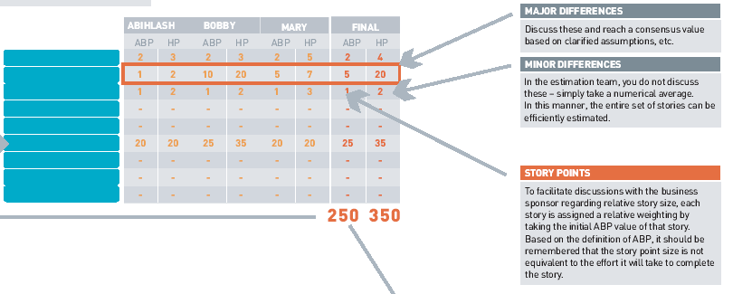


Step 2: Estimate the work
Wide-band-modified Delphi (WBMD)
technique
Notes:
Speaker notes:
Key point to note about the WBMD technique is that estimates are done INDEPENDENTLY by 3 people, who are experienced enough to do an estimate. The goal of the WBMD technique is not to break down each story to a granular level of detail, but to do a holistic estimate of the story based no experience and gut-feel. Each person participating in the estimate, should go through the list quickly and swiftly, coming up with a number.
TO automate this process alittle, some teams have put together a quick and dirty excel that allows indiv to input the ABP and HP, and then the excel highlights those stories where the differences in the 3 estimates are higher than a defined treshhold.
When the estimates are radically different, at a very minimum the team needs to talk about it, and what people were thinking and assuming when they came up with the estimate. If that is not sufficient, the estimate could be furtherbroken down.

Slide 57
Step 3: Define/validate the High Level Plan
Complement risk and value prioritization with dependencies to create/validate a High Level Plan
Synchronize releases with business milestones
Strive to deliver as quickly as possible
_{EAR}
_{Release 2}
_{Release 3}
_{Manage}
Req 3
Req 5
Req 7
Req
Req 2
Req 1
Req 9
Req
Req 1
Req 10
Req 6
Req 8
Req 15
_{Dependencies}
Notes:
Speaker notes:

Slide 58
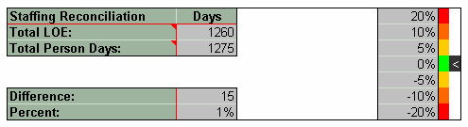
Step 4: Develop the Staffing Plan
The staffing plan defines
  What roles are needed for the project
  When are they needed
  Where are they needed
Take into consideration project/immigration constraints (such as client milestones, visa restrictions) when deriving the Staffing Plan
Reconcile the Staffing plan with the project LOE
The total person days must equal the total LOE.
Notes:
Speaker notes:

Slide 59
Demo: Estimation Tool
Estimation Tool template
Estimation Tool example
NOTE: Always download the latest version
from the Intranet!
Notes:
Speaker notes:

Slide 60
Class Exercise #3
Estimating the project
Instructions (Total time required 120 min)
Split into teams of 2
Using the Scope Matrix and case study from the previous exercise, create your estimate (90 min):
    Break down the work into stories
    Derive the estimate using the WBMD technique
    Create and finalise your estimate in the estimation tool (incl Staffing Plan)
    Create the High level plan
Debrief (30 min)
Notes:
Speaker notes:
See Facilitation notes for details on how to facilitate this session.

Slide 61
Key Takeaways
It is critical to define good stories, as they are used not only to estimate, but also throughout the project execution
The WBMD technique is a proven and simple technique for estimating effort
Creating the estimate is not a stand-alone process, it is an iterative process that relies on several other key inputs such as the high level release plan and the staffing plan

Slide 62
Price the project

Slide 63
Price the project
1. SCOPE
(the what)
2. ESTIMATE
(the effort)
3. PLAN
(the when)
4. PRICE
(the cost)
Tool:
Scope Matrix
Tool:
Estimation sheet
Tool:
High Level Plan
Tool:
Deal Tool
What are we going to do?
Why are we doing it?
How will it be done?
What risks are there?
What is the effort required?
Who will do it?
When will it be done?
What assumptions are we making?
How much will it cost?
Notes:
Speaker notes:
A critical part of selling a project is planning it. Typically a BD team will consist of a CE, a senior PM, Arch and perhaps other SMEs. Typically the senior project manager will drive and own planning the project. The planning should be treated as a mini-project in itself ie it needs to be planned, managed and tracked.

Slide 64
Pricing the project
1. SCOPE
(the what)
2. ESTIMATE
(the effort)
3. PLAN
(the when)
4. PRICE
(the cost)
Tool:
Scope Matrix
Tool:
Estimation Tool
Tool:
High Level Plan
Tool:
Deal Tool
The final price for the project can be derived once the project has been scoped, estimated and planned
The Deal Tool is used to derive the price
  The Staffing Plan is exported from the Estimation Tool, and imported to the Deal Tool
  Discounts and other costs are manually updated in the Deal Tool
  Deal tool and pricing approvals then flow through Stellent
Known client price/budget constraints can influence what is in/out of scope for a project, not the LOE
Notes:
Speaker notes:
Key point to make is that if we find ourselves in a position where the derived price is too high, assuming the estimate has been done with due dilligence, we must revisit what is in and out of scope to meet the price constraint. If we decide not to change the scope and instead reduce the individual story estimates, it will most likely result in the team having to demonstrate heroics.

Slide 65
Recap and Feedback

Slide 66
3 Day Agenda
DAY 1
DAY 2
DAY 3
S|A Overview
Plan a Fusion
Scope the project
Kick off the project
Execute the EAR
Prepare for the case study
Lunch
Scope the project (exercise)
Estimate and plan the project
Plan and execute a release
Execute a Manage engagement
Common pitfalls and stories from the field
Execute the case study
Close and feedback
Notes:
Speaker notes:
Recap what was covered in Day 1 and lookforward to Day 2.
Capture feedback on whiteboard

Slide 67
Thank You!

